Slide 1
Multilevel analysis of individual heterogeneity and discriminatory accuracy (MAIHDA) – using multilevel models to study intersectionality. Video 4 - examples and visualisations.
George Leckie (University of Bristol) Full resource: https://www.ncrm.ac.uk/resources/online/all/?id=20849

Slide 2
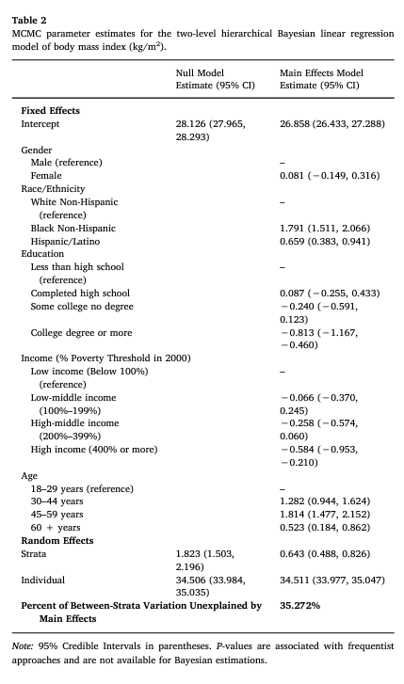
Examples
Evans et al 2018
Outcome variable: BMI (obesity)
Variables defining strata:
Gender (2 categories)
Ethnicity (3 categories)
Income (4 categories)
Education (4 categories)
Age (4 categories)
Potentially 2*3*4*4*4 = 385 strata (but some might be empty)

Slide 3
Examples
Evans et al 2018
How multiplicative are the effects of these variables?
See how strata-level variance reduces when main effects are controlled for
Answer: about 35% multiplicative (so 65% additive)

Slide 4
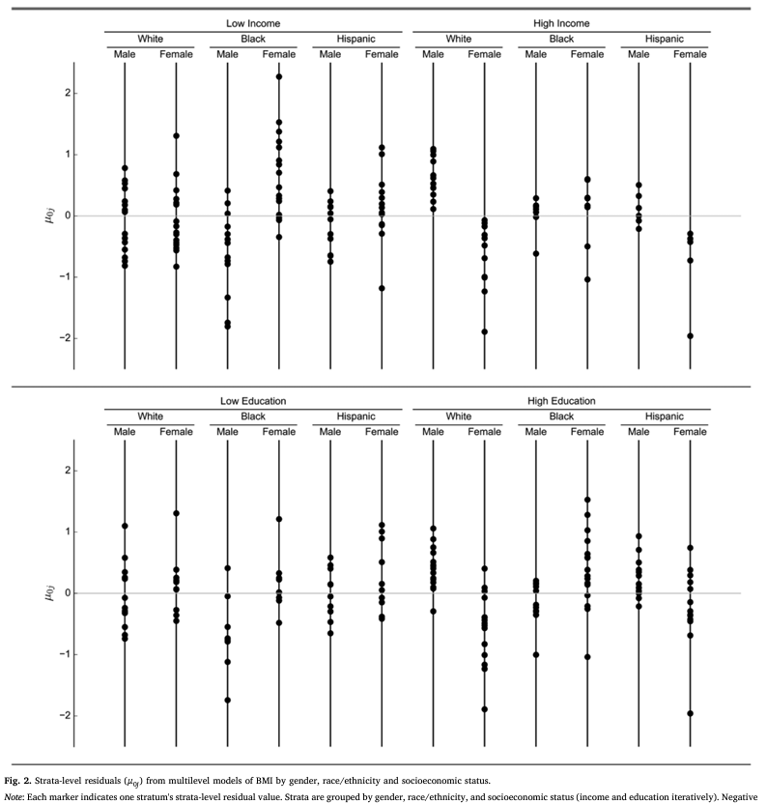
Examples
Evans et al 2018
Plotting individual residuals – tricky when there are so many of them!
Here – plotted by “supercategories”
But require decisions to be made about what you show – that is: which variables to divide things by

Slide 5
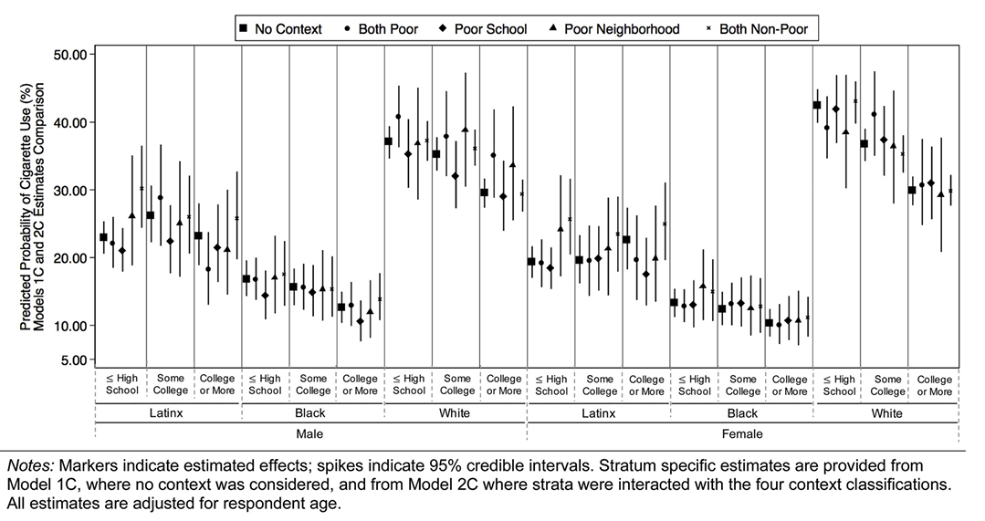
Examples
Other examples (Evans 2019) – but again, requires decisions about how to group…
Important: consider whether you want to report the residuals from model 1 or model 2
Model 1 residuals: these are full predictions (but better: make predictions from model 2 that include both fixed and random part)
Model 2 residuals: These are the multiplicative part only, and are more tricky to interpret than the full predictions – ie they are the differentials from the main effects (eg: is a strata more disadvantaged than we’d expect given the combination of additive disadvantages that they have)

Slide 6
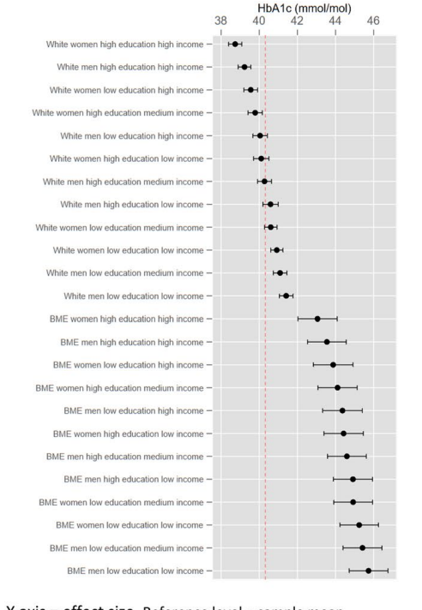
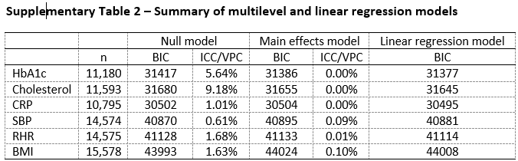
Examples
Holman et al (2019) – these are actually predictions from a standard regression model (the comparison of model 1 and model 2 showed no multiplicative effects)

Slide 7
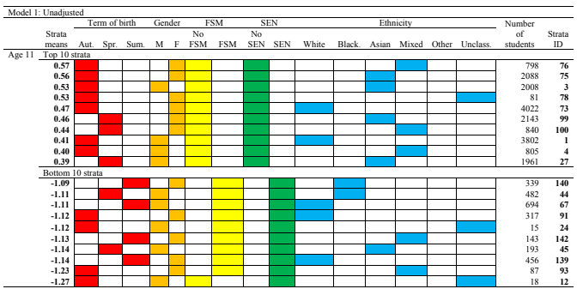
Examples

Slide 8
www.ncrm.ac.uk

